Slide 1

DIYALA UNIVERSITY
COLLEGE OF ENGINEERING
DEPARTMENT OF COMMUNICATION ENGINEERING
Electronic Circuits I
Second stage_ Lecture 6
Asst. lecturer
Wisam Hayder
January 2021

Slide 2
Transistor Switching Networks
The second major application area is switching applications.
When used as an electronic switch, a BJT is normally operated alternately in cutoff and saturation.
Many digital circuits use the BJT as a switch and inverter.
The network of Figure (1.a) can be employed as an inverter in computer logic circuitry.
Notes:
aaa

Slide 3
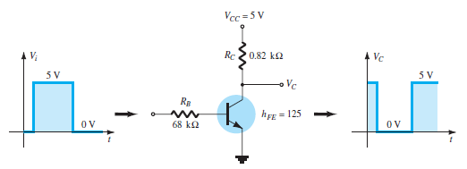
Transistor Switching Networks
Fig.1. a. Transistor inverter
Proper design for the inversion process requires that the operating point switch from cutoff to saturation along the load line depicted in Figure (1-b).
Notes:
aaa

Slide 4
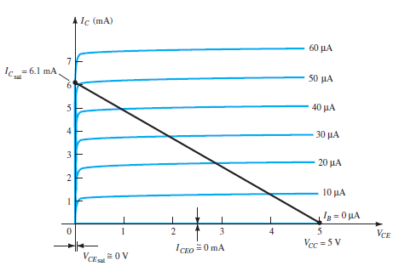
Transistor Switching Networks
Fig.1. b. Transistor inverter
Notes:
aaa

Slide 5



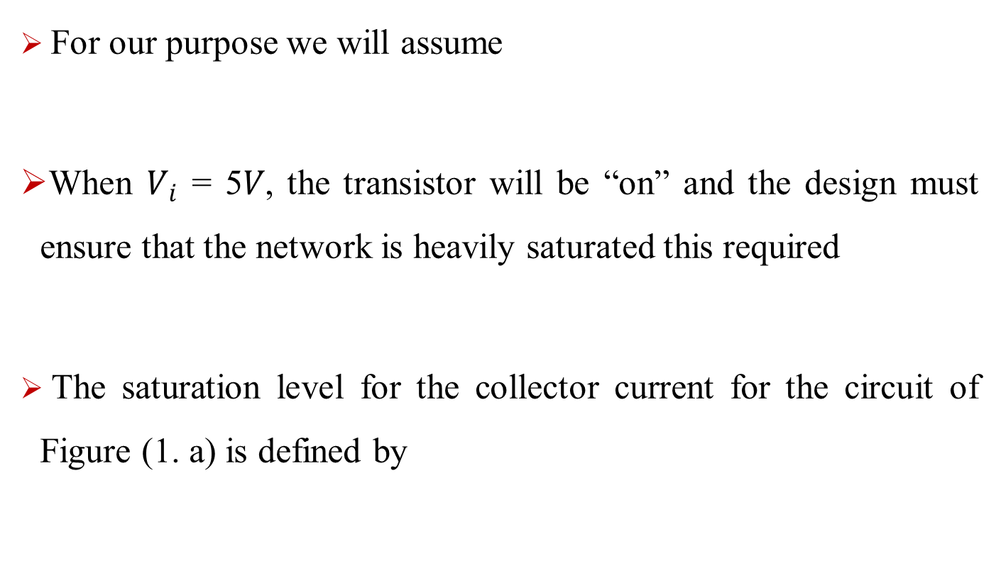
Transistor Switching Networks
For our purpose we will assume
When $V_{i}$ = 5𝑉, the transistor will be “on” and the design must ensure that the network is heavily saturated this required
The saturation level for the collector current for the circuit of Figure (1. a) is defined by
Notes:
aaa

Slide 6


Transistor Switching Networks
For the saturation level we must therefore ensure that the following condition is satisfied
For the network of Figure (1. b)
Notes:
aaa

Slide 7



Transistor Switching Networks
For the saturation level we must therefore ensure that the following condition is satisfied:
For the network of Fig. 1.b , when $V_{i}$ = 5 V, the resulting level of $I_{B}$ is
Testing Eq. Gives
Notes:
aaa

Slide 8

Transistor Switching Networks
Figure (2) illustrates the basic operation of a BJT as a switching device.
In part (a), the transistor is in the cutoff region because the base-emitter junction is not forward-biased. In this condition, there is, ideally, an open between collector and emitter, as indicated by the switch equivalent.
The cutoff condition will result in a resistance level of the following magnitude:
Notes:
aaa

Slide 9
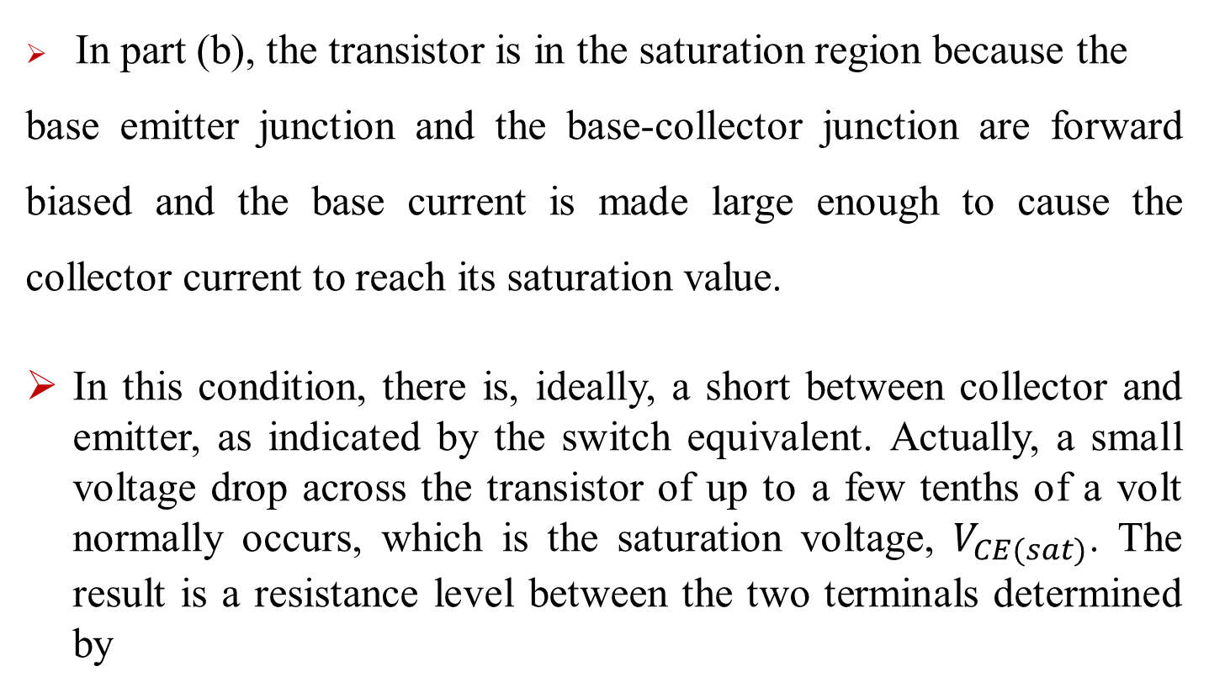
Transistor Switching Networks
In part (b), the transistor is in the saturation region because the
base emitter junction and the base-collector junction are forward biased and the base current is made large enough to cause the collector current to reach its saturation value.
In this condition, there is, ideally, a short between collector and emitter, as indicated by the switch equivalent. Actually, a small voltage drop across the transistor of up to a few tenths of a volt normally occurs, which is the saturation voltage, $V_{CE(sat)}$. The result is a resistance level between the two terminals determined by
Notes:
aaa

Slide 10
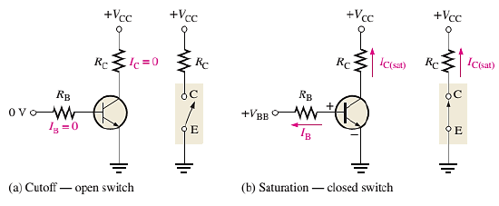
Transistor Switching Networks
Fig. 2
Notes:
aaa

Slide 11
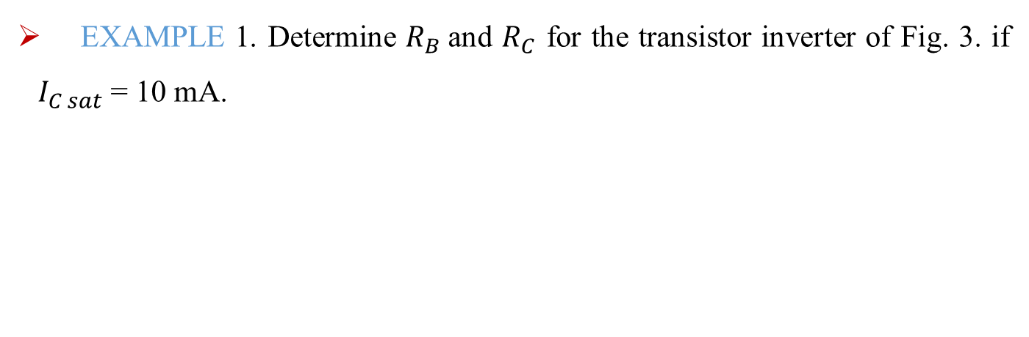
Transistor Switching Networks
EXAMPLE 1. Determine $R_{B}$and $R_{C}$ for the transistor inverter of Fig. 3. if $I_{C sat}$= 10 mA.
Fig. 3. Inverter for Example 1.
Notes:
aaa

Slide 12
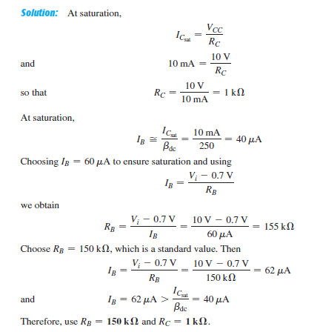
Transistor Switching Networks
Notes:
aaa

Slide 13
BJT AC Analysis
BJT Modeling and AC Equivalent Circuit
Basic Concepts:
The key to the transistor small-signal analysis is the use of ac equivalent circuits or models.
A model is the combination of circuit elements, properly chosen, that best approximates the actual behavior of a semiconductor device (BJT) under specific operating conditions.
Notes:
aaa

Slide 14
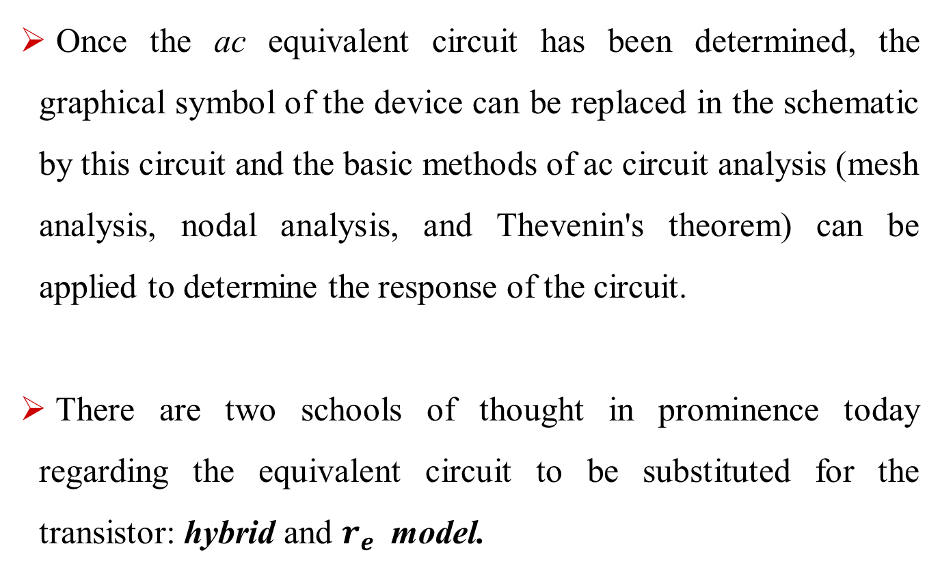
BJT AC Analysis
Once the ac equivalent circuit has been determined, the graphical symbol of the device can be replaced in the schematic by this circuit and the basic methods of ac circuit analysis (mesh analysis, nodal analysis, and Thevenin's theorem) can be applied to determine the response of the circuit.
There are two schools of thought in prominence today regarding the equivalent circuit to be substituted for the transistor: hybrid and $r_{e}$ model.
Notes:
aaa

Slide 15
BJT AC Analysis
In summary, therefore, the ac equivalent of a transistor network is obtained by:(see Fig. 4,5and 6):
1. Setting all dc sources to zero and replacing them by a short-circuit equivalent.
2. Replacing all capacitors by a short-circuit equivalent.
3. Removing all elements bypassed by the short-circuit equivalents introduced by steps 1 and 2.
4. Redrawing the network in a more convenient and logical form.
Notes:
aaa

Slide 16
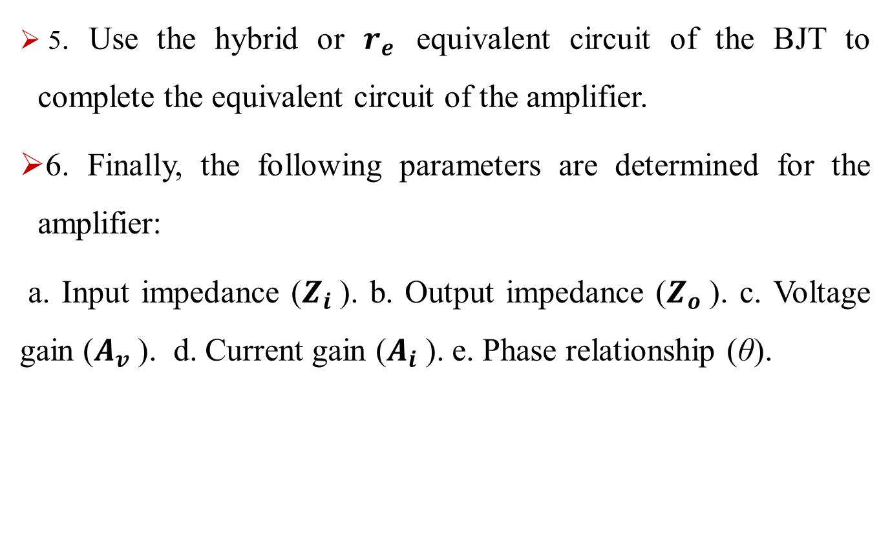
BJT AC Analysis
5. Use the hybrid or $r_{e}$ equivalent circuit of the BJT to complete the equivalent circuit of the amplifier.
6. Finally, the following parameters are determined for the amplifier:
a. Input impedance ($Z_{i}$). b. Output impedance ($Z_{o}$). c. Voltage gain ($A_{v}$). d. Current gain ($A_{i}$). e. Phase relationship (θ).
Notes:
aaa

Slide 17
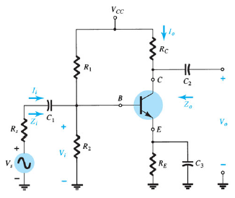
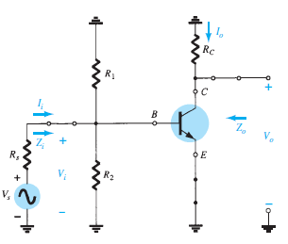
BJT TRANSISTOR MODELING
Fig.4. (Transistor circuit under
examination in this introductory
discussion)
Fig 5. The network of Fig. 4.
Following removal of the dc
supply and insertion of the
short-circuit Equivalent for the capacitors.
Notes:
aaa

Slide 18
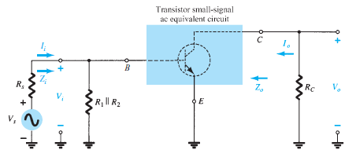
BJT TRANSISTOR MODELING
Circuit of Fig. 6 redrawn for small-signal ac analysis.
Notes:
aaa

Slide 19
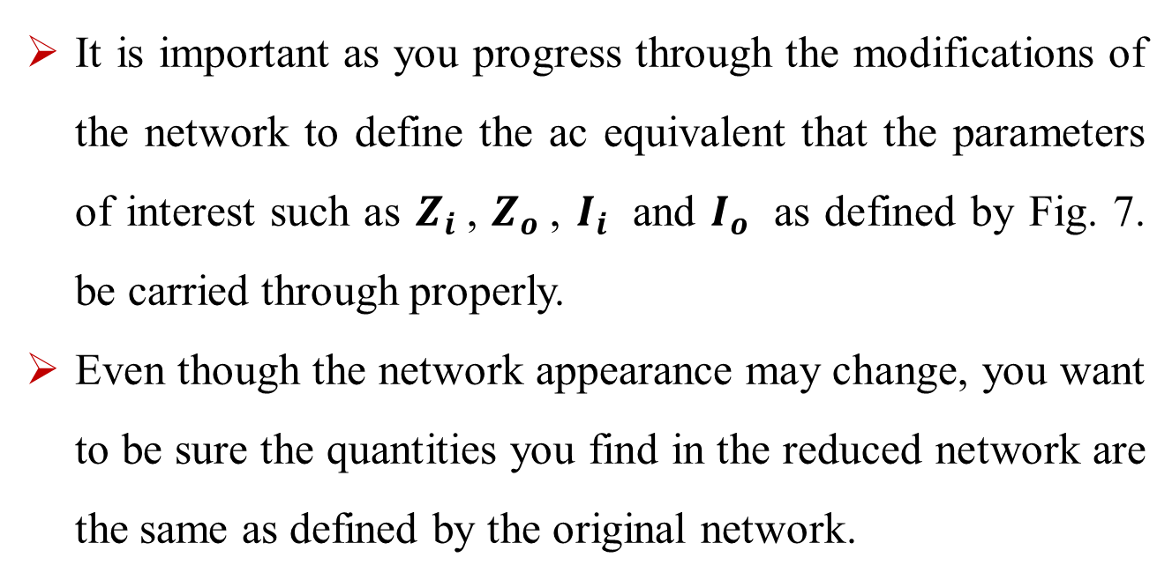
BJT TRANSISTOR MODELING
It is important as you progress through the modifications of the network to define the ac equivalent that the parameters of interest such as $Z_{i}$, $Z_{o}$, $I_{i}$ and $I_{o}$ as defined by Fig. 7. be carried through properly.
Even though the network appearance may change, you want to be sure the quantities you find in the reduced network are the same as defined by the original network.

Slide 20
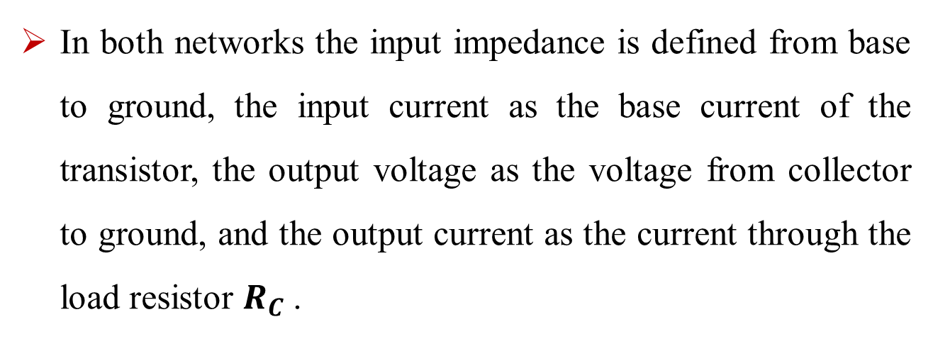
BJT TRANSISTOR MODELING
In both networks the input impedance is defined from base to ground, the input current as the base current of the transistor, the output voltage as the voltage from collector to ground, and the output current as the current through the load resistor $R_{C}$.

Slide 21
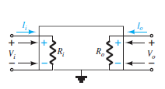
BJT TRANSISTOR MODELING
Fig. 7. Defining the important parameters of any system.
Fig. 8. Demonstrating the reason for the defined directions and polarities.

Slide 22
BJT TRANSISTOR MODELING
The parameters of Fig. 7. can be applied to any system whether it has one or a thousand components.
The directions of the currents, the polarities of the voltages, and the direction of interest for the impedance levels are as appearing in Fig. 7 .
In other words, the input current Ii and output current Io are, by definition, defined to enter the system. If, in a particular example, the output current is leaving the system rather than entering the system as shown in Fig. 7 , a minus sign must be applied.
The defined polarities for the input and output voltages are also as appearing in Fig. 7 . If Vo has the opposite polarity, the minus sign must be applied.

Slide 23
BJT TRANSISTOR MODELING
Note that Zi is the impedance “looking into” the system, whereas Zo is the impedance “looking back into” the system from the output side. By choosing the defined directions for the currents and voltages as appearing in Fig. 7 , both the input impedance and output impedance are defined as having positive values.
For example, in Fig. 8 the input and output impedances for a particular system are both resistive.

Slide 24
BJT TRANSISTOR MODELING
For the direction of Ii and Io the resulting voltage across the resistive elements will have the same polarity as Vi and Vo , respectively.
If Io had been defined as the opposite direction in Fig. 7 a minus sign would have to be applied.
For each case Zi = Vi/Ii and Zo = Vo/Io with positive results if they all have the defined directions and polarity of Fig. 7.

Slide 25
BJT TRANSISTOR MODELING
If the output current of an actual system has a direction opposite to that of Fig. 7 a minus sign must be applied to the result because Vo must be defined as appearing in Fig. 7 .
Keep Fig. 7 in mind as you analyze the BJT networks in this our studies..
It is an important introduction to “System Analysis,” which is becoming so important with the expanded use of packaged IC systems.

